Slide 1

Pride and Prejudice
(《傲慢与偏见》）
——by Rachel

Slide 2
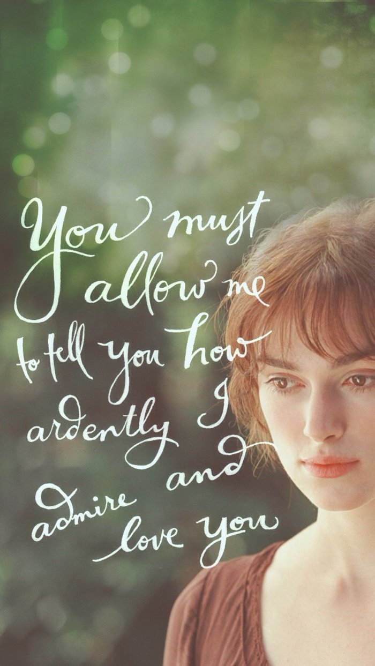
Pride and Prejudice is one of my favourite books.I have read it when I was about ten years old and I have also watched the movie “Pride and Predudice”directed by an American film studio .
The simple but pure plot,the wonderful song,the classical costume,the beatiful and stubborn actress,all of these moved me deeply.
——Keira Knightley

Slide 3
·A bref introduction to the author：
Jane Austen was an English novelist who has the ability to makes wonderful but also touching comedy out of something serious.
Her realism, biting social commentary and masterful(熟练的）use of free indirect speech have earned her a place as one of the most widely read and most beloved writers in English literature.
Her most famous works including Pride and Prejudice ,the one for which she is most known are set in the world of the English gentry in the late 18th century.

Slide 4
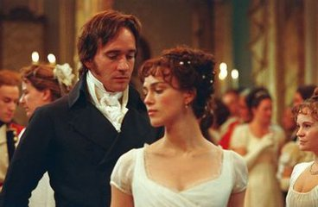
The main plot of the novel is driven by the love-hate relationship between Elizabeth and Mr Darcy,a wealthy aristocrat(贵族）.At first,they don‘t get on. Elizabeth finds Darcy too proud;She feels he thinks he is better than everyone else.She thinks that he looks down upon her family in particular.Darcy,while admiring Elizabeth，believes that she has taken unfairly to him.The pleasure of the novel is reading how the comical and unexpected ending is achieved.

Slide 5
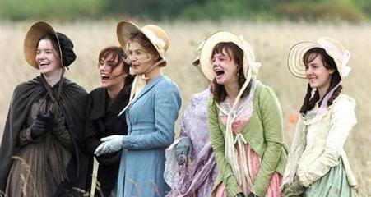
·classic statement ：
·Some people even did not intend to do bad things, can in fact it can still do wrong, misery consequences. Every careless and don't see other people's well-intentioned, and the lack of a decisive person, all similar to harm them.
·Pretend modesty often is nonsense, sometimes just is the beat around the bush boast.
·Only deep love will persuade me to marry.Which is why i'll end up an old maid.

Slide 6
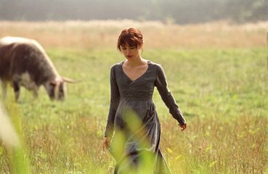
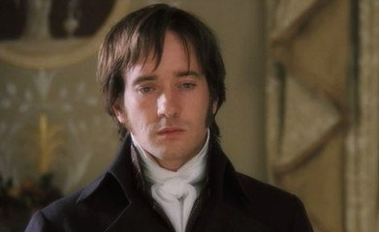
In fact,sometimes we may all be pride and proudhearted.we may assess(评价） the others only depend on their background . we might hide our true heart and pretend .we might despise the others without any reason……
But why don’t we ask ourselves in our heart :what do we feel in fact? What do we need in fact? What do we hate and love in fact?
Why not express our real feelings at once?Why not chase the happiness we really want ?Why not go through the hindrances(障碍） that set by ourselves?

Slide 7
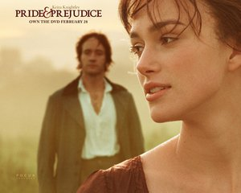
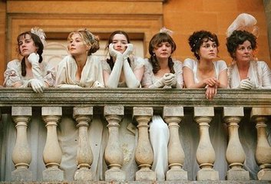
“Don't judge people by first impressions and confess your weakness bravely.”
I think this might be my greatest inspiration from the book.

Slide 8
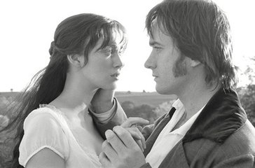
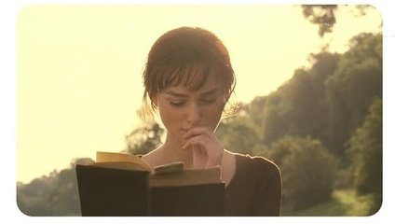
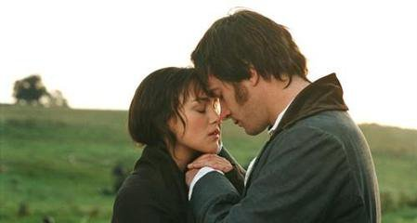
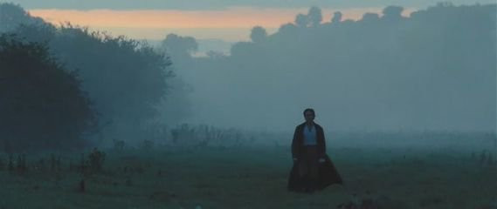
Thank you! :)

